Slide 1



FINANCIAL RISK PREDICTION
USING DE
- BY THE DYNAMIC DYNAMOS
- GUIDED BY RAVI KUMAR N K

Slide 2
Problem Statement
Financial institutions face risks in areas like lending, investments, and fraud detection. The challenge is to process financial data to predict and assess these risks in real-time, enabling smarter decision-making.
Objective
To perform data preprocessing and apply machine learning models to predict and detect fraudulent transactions, enabling financial institutions to take proactive measures in real-time.

Slide 3
DATA OVERVIEW AND CHALLENGES
Data Columns: The dataset includes the following columns: CustomerID, CreditScore, TransactionAmount, AccountBalance, TransactionType, TransactionTimestamp, PortfolioRiskScore, NumPreviousDefaults, CustomerIncome, InvestmentRatio, and Class.
Challenges:
Data Imbalance: The dataset has an unequal distribution between fraudulent and legitimate transactions, making it challenging to accurately predict fraud.
Feature Complexity: The complexity of features, such as numerical and categorical data, requires careful preprocessing and modeling to extract meaningful insights.

Slide 4


Our Solution

Slide 5
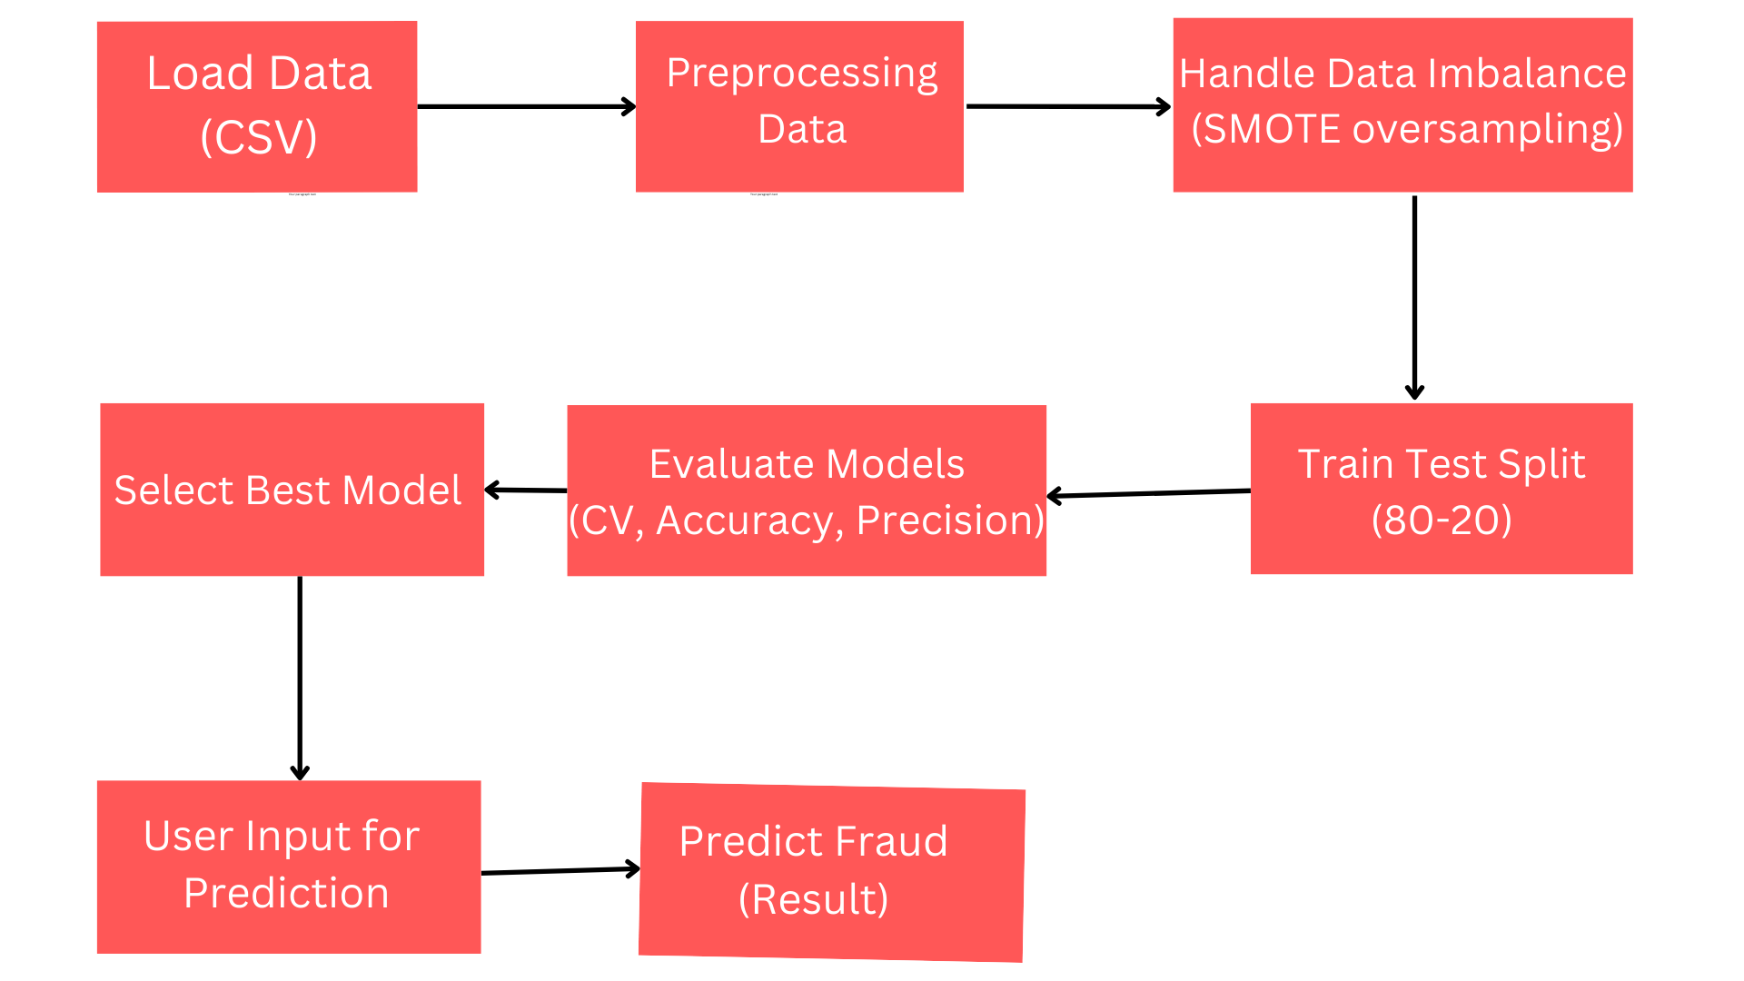
Data Flow Diagram

Slide 6
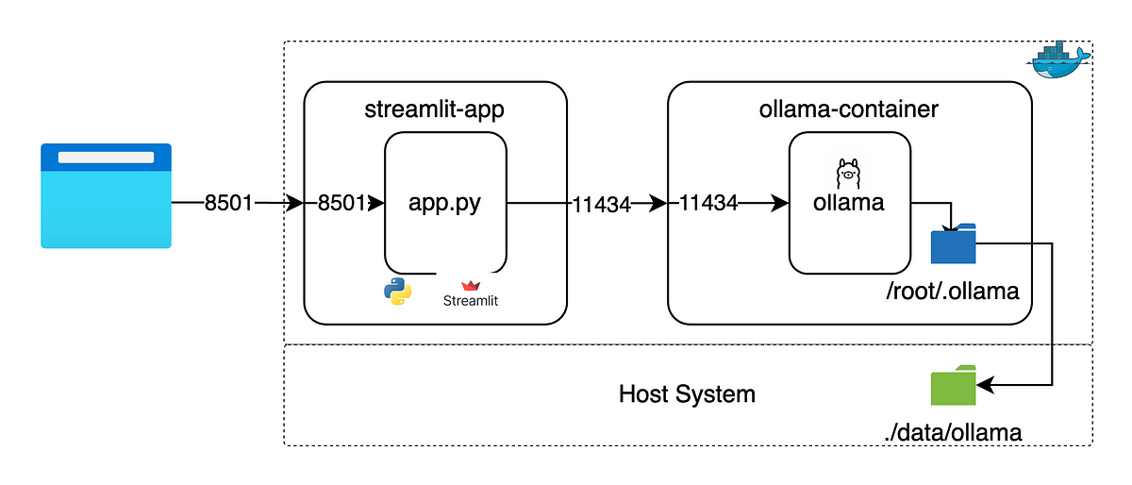
Data flow of Ollama Chatbot

Slide 7

Data Preprocessing Techniques
Handling Missing Values
Handling Duplicates
Feature Scaling
Dropped rows with missing values or imputed values based on mean/median
Removed any duplicate transactions to avoid biases.
Used to standardize or normalize independent variables (features) so that they have a uniform range
Standardization
Outlier handling
For algorithms that assume normal distribution (e.g., Logistic Regression), applied StandardScaler.
Removed outlier from the model.

Slide 8
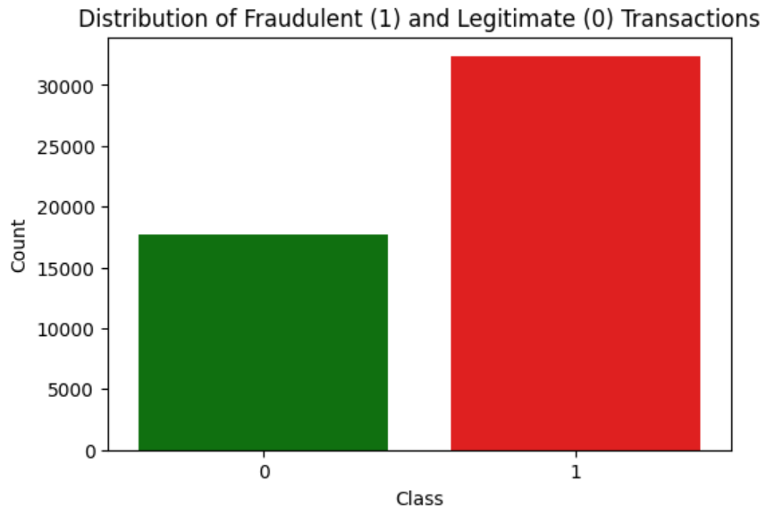
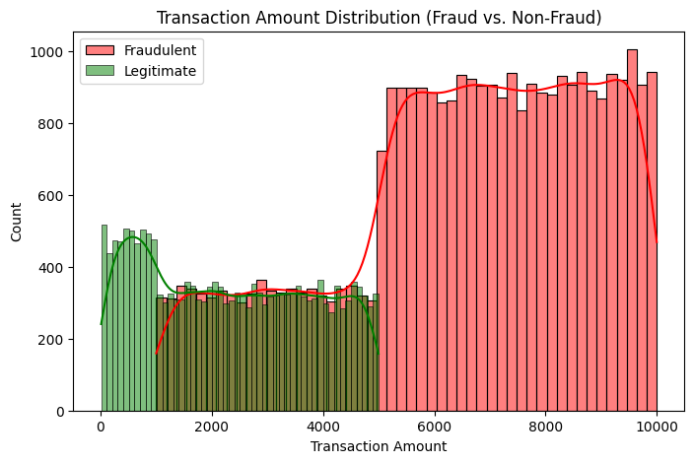
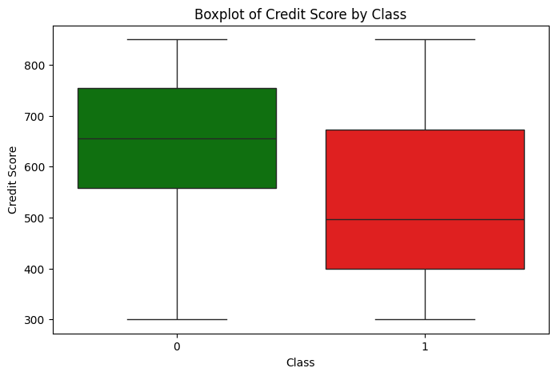
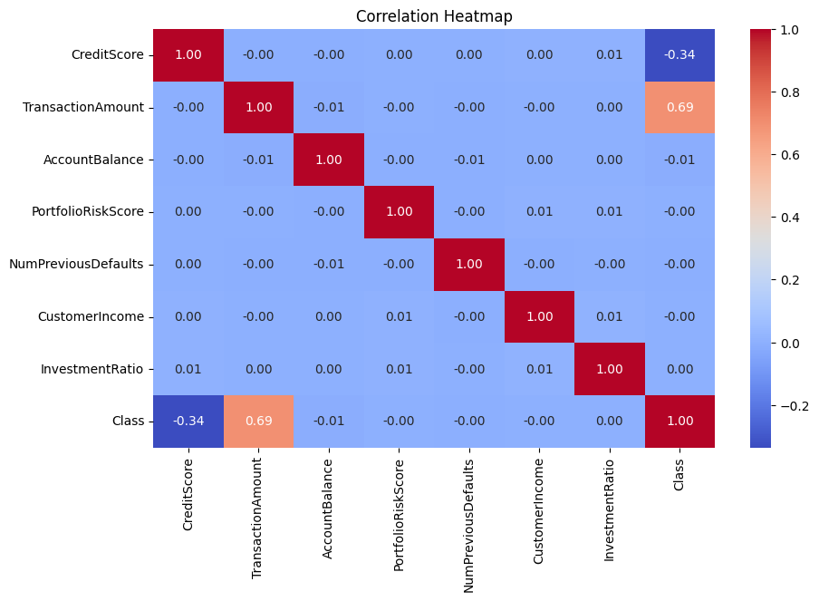
Exploratory Data Analysis (EDA)

Slide 9
Model Evaluation and Performance Metrics
Metrics Evaluated: The models are evaluated based on Accuracy, Precision, Recall, F1 Score, and ROC AUC to assess their performance in fraud detection and risk prediction.
Models Used: The models used include Support Vector Machine (SVM), K-Nearest Neighbors (KNN), Decision Tree.
The Decision Tree model outperforms all other models, achieving the highest scores with an Accuracy of 0.998917, Precision of 0.99783, Recall of 1.0, F1 Score of 0.998914, and ROC AUC of 0.998921.
Selection Criteria: The best model is selected based on accuracy, ensuring effective fraud detection and risk management.

Slide 10
Conclusion and Future Work
The app successfully detects fraud and evaluates financial risk using machine learning and also added the ask the expert chatbot option which maintains the records of past conversations.
Key Takeaways:
Decision Tree Model performed well for fraud detection.
SMOTE helped to improve the model performance on imbalanced data.
Future Work:
Incorporating more complex models.
Adding additional features for better fraud prediction.

Slide 11

Thank you!

